Slide 1
Growth of Functions
Computer Science, Purdue University
Copyright McGraw Hill, Rosen, Discrete Mathematics and its Applications

Slide 2
Growth of Functions
Using Big-O Notation
Example: Show that 7x² is O(x³).
Solution: When x > 7, 7x² < x³. Take C =1 and k = 7 as witnesses to establish that 7x² is O(x³).
(Would C = 7 and k = 1 work?)
Example: Show that n² is not O(n).
Solution: Suppose there are constants C and k for which n² ≤ Cn, whenever n > k. Then (by dividing both sides of n² ≤ Cn) by n, then n ≤ C must hold for all n > k. A contradiction!
Computer Science, Purdue University

Slide 3

Growth of Functions
Big O Estimates for Polynomials
Example: Let
where are real numbers with a_{n} ≠0.
Then f(x) is O(x^{n}).
Proof: |f(x)| = |a_{n}x^{n} + a_{n-1} x^{n-1} + ∙∙∙ + a₁x¹ + a₀|
≤ |a_{n}|x^{n} + |a_{n-1}| x^{n-1} + ∙∙∙ + |a₁|x¹ + |a₀|
= x^{n} (|a_{n}| + |a_{n-1}| /x + ∙∙∙ + |a₁|/x^{n-1} + |a₀|/ x^{n})
≤ x^{n} (|a_{n}| + |a_{n-1}| + ∙∙∙ + |a₁|+ |a₀|)
Take C = |a_{n}| + |a_{n-1}| + ∙∙∙ + |a₀| and k = 1. Then f(x) is O(x^{n}).
The leading term a_{n}x^{n} of a polynomial dominates its growth.
Assuming x > 1
Computer Science, Purdue University

Slide 4
Growth of Functions
Big-O Estimates for Some Important Functions
Example: Use big-O notation to estimate the sum of the first n positive integers.
Solution:
Example: Use big-O notation to estimate the factorial function
Solution:
Computer Science, Purdue University

Slide 5
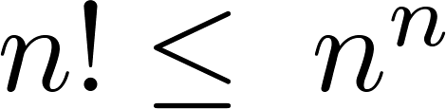

Growth of Functions
Big-O Estimates for Some Important Functions
Example: Use big-O notation to estimate log n!
Solution: Given that (previous slide)
then .
Hence, log(n!) is O(n∙log(n)) taking C = 1 and k = 1.
Computer Science, Purdue University

Slide 6
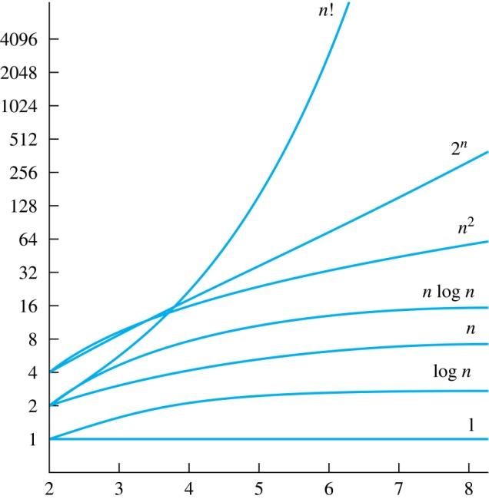
Growth of Functions
Big-O Estimates for Some Important Functions
Computer Science, Purdue University

Slide 7
Growth of Functions
Big-O Estimates for Some Important Functions
If d > c > 1, then
n^{c} is O(n^{d}), but n^{d} is not O(n^{c}).
If b > 1 and c and d are positive, then
(log_{b} n)^{c} is O(n^{d}), but n^{d} is not O((log_{b} n)^{c}).
If b > 1 and d is positive, then
n^{d} is O(b^{n}), but b^{n} is not O(n^{d}).
If c > b > 1, then
b^{n} is O(c^{n}), but c^{n} is not O(b^{n}).
Computer Science, Purdue University

Slide 8
Growth of Functions
Combinations of Functions
If f₁ (x) is O(g₁(x)) and f₂ (x) is O(g₂(x)) then
( f₁ + f₂ )(x) is O(max(|g₁(x) |,|g₂(x) |)).
See next slide for proof
If f₁ (x) and f₂ (x) are both O(g(x)) then
( f₁ + f₂ )(x) is O(g(x)).
If f₁ (x) is O(g₁(x)) and f₂ (x) is O(g₂(x)) then
( f₁ f₂ )(x) is O(g₁(x)g₂(x)).
Computer Science, Purdue University

Slide 9
Growth of Functions
Combinations of Functions
If f₁ (x) is O(g₁(x)) and f₂ (x) is O(g₂(x)) then
( f₁ + f₂ )(x) is O(max(|g₁(x) |,|g₂(x) |)).
By the definition of big-O notation, there are constants C₁,C₂ ,k₁,k₂ such that | f₁ (x) ≤ C₁|g₁(x) | when x > k₁ and f₂ (x) ≤ C₂|g₂(x) | when x > k₂ .
|( f₁ + f₂ )(x)| = |f₁(x) + f₂(x)|
≤ |f₁ (x)| + |f₂ (x)| by the triangle inequality |a + b| ≤ |a| + |b|
|f₁ (x)| + |f₂ (x)| ≤ C₁|g₁(x) | + C₂|g₂(x) |
≤ C₁|g(x) | + C₂|g(x) | where g(x) = max(|g₁(x)|,|g₂(x)|)
= (C₁ + C₂) |g(x)|
= C|g(x)| where C = C₁ + C₂
Therefore |( f₁ + f₂ )(x)| ≤ C|g(x)| whenever x > k, where k = max(k₁,k₂).
Computer Science, Purdue University

Slide 10
Growth of Functions
Big O Example
Put the functions below in order so that each function is big-O of the next function on the list.
f₁(n) = (1.5)^{n}
f₂(n) = 8n³+17n² +111
f₃(n) = (log n )²
f₄(n) = 2^{n}
f₅(n) = log (log n)
f₆(n) = n² (log n)³
f₇(n) = 2^{n} (n² +1)
f₈(n) = n³+ n(log n)²
f₉(n) = 10000
f₁₀(n) = n!
Computer Science, Purdue University

Slide 11
Growth of Functions
Big O Example
We solve this exercise by successively finding the function that grows slowest among all those left on the list.
f₉(n) = 10000 (constant, does not increase with n)
f₅(n) = log (log n) (grows slowest of all the others)
f₃(n) = (log n )² (grows next slowest)
f₆(n) = n² (log n)³ (next largest, (log n)³ factor smaller than any power of n)
f₂(n) = 8n³+17n² +111 (tied with the one below)
f₈(n) = n³+ n(log n)² (tied with the one above)
f₁(n) = (1.5)^{n} (next largest, an exponential function)
f₄(n) = 2^{n} (grows faster than one above since 2 > 1.5)
f₇(n) = 2^{n} (n² +1) (grows faster than above because of the n² +1 factor)
f₁₀(n) = n! ( n! grows faster than c^{n} for every c)
Computer Science, Purdue University

Slide 12
Thank You

